Slide 1
Fundamentals of Great SQL Query Performance
Matt Wigdahl, ScriptPro LLC

Slide 2
Intro: Speaker and Course
Matt Wigdahl, Director of Software Quality at ScriptPro LLC
SQL Server developer and DBA for 15 years
Battle-tested tactics to improve your query writing and debugging
OLTP, but includes some mass data retrieval
Notes:
3 Maxims for Maximum Performance -- Larry Wall – Laziness, Impatience, and Hubris
Join types, Seeks, Scans, Index fundamentals – how to recognize them, what they mean, how they work
Sargability: (the ability for the optimizer to use an index to seek the results)
Encapsulation: (various flavors of functions, CTEs)

Slide 3
Overview
The 3 Maxims for Maximum Performance
Join / Seek / Scan / Index Fundamentals
Understanding and dealing with the most common causes of poor performance
Lack of sargability
Parameter sniffing misfires
Misuse of encapsulation

Slide 4
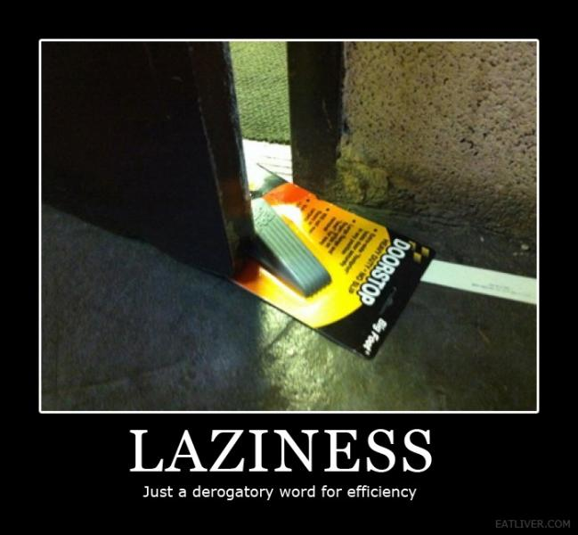
3 Maxims for Maximum Performance
The Maxim of Laziness
Minimize the amount of data touched at each step of a query.
Notes:
Laziness – It’s not a workout -- don’t make SQL Server sweat. The less data you touch and the less work you make SQL do, the faster your query runs.

Slide 5
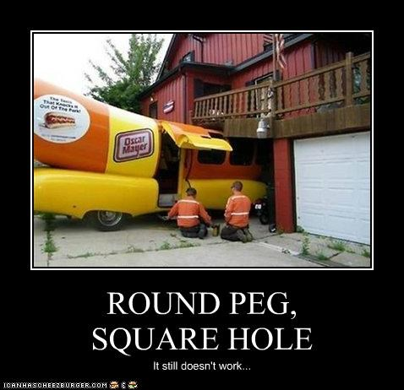
The Second Maxim
The Maxim of Conformity
Swim with the set-based stream
No RBAR (Row By Agonizing Row)
Notes:
Conformity – Swim with the stream. SQL is designed for set-based operation – use it! Queries are fastest when they intelligently use standard mechanisms.

Slide 6
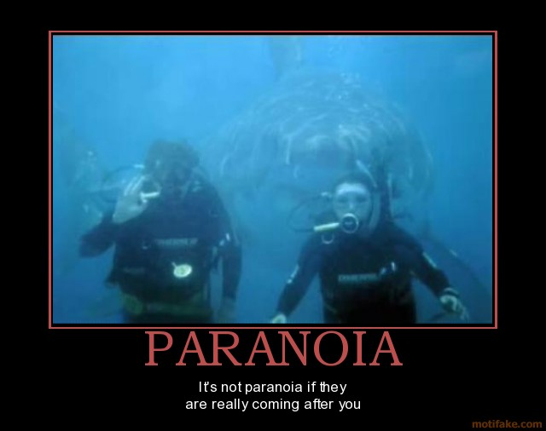
The Third Maxim
The Maxim of Paranoia
SQL Server lies!
Always confirm performance metrics using different methods.
Notes:
Paranoia – SQL Server lies. Lies constantly. Lies like a rug. Don’t rely on a single set of metrics, always cross-check. For goodness’ sake, don’t rely on intuition alone!

Slide 7
Anatomy of a SQL Query
SELECT (INSERT/UPDATE/DELETE)
FROM
INNER/LEFT JOIN (ON)
CROSS/OUTER APPLY
WHERE
GROUP BY
HAVING
ORDER BY
Notes:
These are the basic query constructs you will see all the time. Red fields are where your eyes should go right away, because that’s where performance problems are usually lurking. That’s because they contain the predicates, and predicates are one of the main drivers of the query optimizer’s choice of plan.
You can have problems based on the number of and the specific choices of tables / functions also, so the other clauses don’t get off scot free.

Slide 8
10,000-Foot Lifecycle of a SQL Query
When you submit a query…
It’s parsed into a “parse tree”
Optimizer generates a plan
Plan is executed
Results are returned
Notes:
Plan generation -- Based on statistics and the topology of the tables and indexes, the optimizer comes up with the best query plan it can.

Slide 9
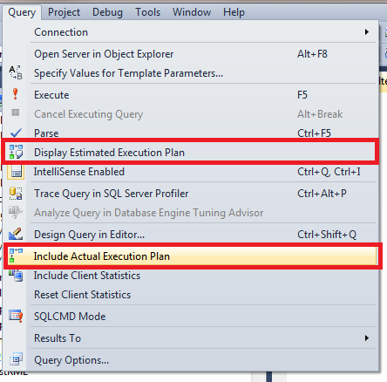
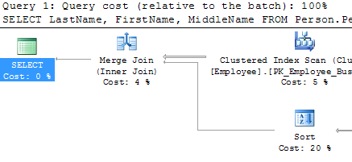
Execution Plan Output
Notes:
Get plan from SSMS – either estimated or actual. Estimated is based on statistics at time of compilation, actual is what the server actually does with your query at the point of execution. Estimated plans are the ones stored in cache.

Slide 10

Execution Plan 101A1 – Nested Loop
Nested Loop
Best if one input is very small
Each row tested against each other row
Scales poorly
Notes:
Testing every row against every other row – O(N*M).

Slide 11
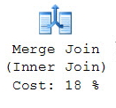
Execution Plan 101A2 – Merge
Merge
Best if inputs are both sorted on join key and similar size
Iterates through rows for both tables in sorted order

Slide 12
Animated Merge
Notes:
Each list is incremented when it’s the smallest value. After a match, the last one to be incremented is incremented again.
As you can see, this can be quite fast, as each list is iterated over exactly once – O(N + M). If you have to sort the lists, it’s O(N log N + M log M), and requires memory to do the sorts.
Image credit: sqlity

Slide 13

Execution Plan 101A3 – Hash
Hash
Best in other cases
Versatile, can indicate issues
Needs memory for hash table
Can “spill” if hash is larger than estimated or allowed, and require on-the-fly changes in algorithm
Notes:
Hash table is built using the smaller of the two “sides”, then each row in the larger table “probes” the hash table – the join criteria are hashed and compared to the hash table.
Can “spill” and require changes in algorithm – get warnings in Query Analyzer.

Slide 14
Execution Plan 101A Wrapup -- Big-O
Loop -- O(N * M) [O(N²)]
Hash -- O(N + M) [O(N)]
Merge
O(N + M) if sorted [O(N)]
O(N log N + M log M) if not sorted [O(N log N)]
So why do we ever use anything other than Hash?
Overhead (memory, algorithmic)
Notes:
Hash needs memory and time up front for building the hash table, possible that that constant overhead can be considerable in some cases.
Nested Loop can get going right away, no real overhead, no memory consumption. For asymmetric sets where N * M << N * N, this can be decisive.
Merge is great if the set is sorted or if you are going to have to sort anyway – in those cases, can be better to sort up front and use lower-overhead merge.

Slide 15

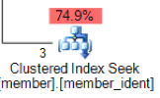
Execution Plan 101B – Read Types
Table / Index Scan
Iterates over the whole structure, testing the predicate
Generally undesirable
Index Seek
Navigates to specific rows of the index using the predicate (or a portion thereof)
Generally desirable
Notes:
Scan vs seek – one of the most important things to be able to recognize in the execution plan.
Icon is a nice visual hint.

Slide 16

Index Fundamentals
The index is a B+Tree with two node types…
Think of a phone book
Multiple pieces of data
Nested ordering
The column order is very important
Finding all last names that start with ‘Dav’ is easy
Finding all first names that start with ‘Dav’ is not
Notes:
Simplest analogy for this – the simple phone book

Slide 17
Sargability
SARG
Acronym from “Search ARGument”
Refers to predicate operators that can be executed using index seeks
“id = 500” is a predicate expression
“=“ is the predicate operator
Needs to be on a first-column index to use – just like the phone book

Slide 18
Nonsargable Predicates
Nonsargable:
Functions with columns as parameters (UDF or not)*
LIKE with leading wildcards (LIKE ‘%slow%’)
Certain implicit type conversions
Dangerous in ON, WHERE, HAVING

Slide 19
More Sargability
Technically sargable -- usually scan anyway: NOT IN, NOT LIKE, !=
Sargable and often produce seeks:
LIKE with trailing wildcard (LIKE ‘fast%’)
<, <=, >, >=, =, IN, BETWEEN
Sargability isn’t a guarantee that you’re going to get an index seek, but without it you definitely won’t.

Slide 20
AND is OR, OR is AND
LastName LIKE ‘Dav%’ AND PhoneNumber LIKE ‘%555%’
Works fine, get a nice seek
LastName LIKE ‘Dav%’ OR PhoneNumber LIKE ‘%555%’
Slow, will scan

Slide 21
Parameter Sniffing
“When I run the stored procedure it takes 45 seconds. When I just run the query in SSMS, it takes 50 milliseconds.”
Gets a bum rap. Generally desirable.
Optimizes a stored procedure for a particular parameter value.

Slide 22
Parameter Sniffing – The Dark Side
Can bite you when you have wide statistical variance for different parameter values
Bad Cardinality Estimates
Poor join type choices
Insufficient memory grants that spill to TempDB
Can also miss opportunities to use better indexes

Slide 23
Parameter Sniffing Controls
Run everything as ad hoc SQL!
WITH RECOMPILE
“Masking”
OPTIMIZE FOR…
UNKNOWN (“MEDIOCRE” – Kendra Little)
( @p1 = 5, @p2 UNKNOWN )

Slide 24
Know Your UDFs
Three types – The Good, The Bad, and The Ugly (Hugo Kornelis)
The Good: Inline Table Valued
The Bad: Scalar
The Ugly: Multistatement Table Valued

Slide 25
Scalar UDFs
Scalar – Takes N parameters, returns single value.
Scalar questionable in SELECT, avoid in other clauses:
Evaluation forces RBAR plans
Low cost estimate can force bad plans
Force serial section in plan
Black box in execution plan

Slide 26
Multistatement Table-Valued UDFs
They take N parameters and return a resultset.
Can have multiple SQL statements in them.
Resultset’s format must be defined up front as a table variable.
Resultset must be populated and returned during UDF.
They have three major issues:
Fixed cardinality estimate of 1 (100 for SQL 2014)
Force serial section in your plan
Black box

Slide 27
Inline Table-Valued UDFs
Also take N parameters and return resultset.
Only a single statement allowed, and it must generate the resultset directly.
They are generally awesome:
More like “parameterized views”
Fully optimizable
No cardinality opacity

Slide 28
Attractive Nuisances / Red Flags
Cursors
Scalar UDFs (outside SELECT)
Multistatement table-valued UDFs
Table variables (yes, even in SQL 2014)
Nonsargable predicates
Questionable predicate columns / Curiously missing indexes

Slide 29
You CAN Handle the Truth
Acquire execution plan from SSMS
Look past the graphics
SET STATISTICS TIME ON
SET STATISTICS IO ON
SET STATISTICS PROFILE ON (with SHOWPLAN permission)
Capture performance metrics in Profiler / XEvents

Slide 30
Resource Detail
CPU
Generally means you’re doing something huge with a lot of data modification – excess UDF execution
I/O
Usually means inefficient joins (hash) or table / index scans – nonsargable predicates, bad plans
Network
Trying to return too large of a data set
Memory
Lots and lots of ad hoc queries
Inefficient queries buffering lots of data

Slide 31
Hell is Other People
Locking / Blocking / Concurrency
Optimistic vs Pessimistic locking
Isolation levels
Lock granularity – Row / Page / Table
Sp_lock
Don’t hold transactions open for a long time
Deadlocking
I have A and want B. You have B and want A.
Access things in a consistent order
Notes:
Jean-Paul Sartre (No Exit)

Slide 32
Questions?

